Slide 1
Session3:#MenoPause Connect Women's Health Research, Maternal Health, PCOS, Hormonal Imbalance Futuristic Medicine for Vitality and Performance
Dr Amanda Noovao Hill, Obstetrician & Gynaecologist, Head of Secretariat & Vice President, PSRH
Notes:
Bula Vinaka, thank you for the introductions and the invitation to participate in this conference.
I have no disclosures to make.
My apologies for rearranging the title of this talk, but I will keep to my 10minute time allocation.
This was necessary to demonstrate that women’s health needs are a continuum across her lifespan
I acknowledge that the audience is a mix of medical professionals and philanthropists, so the content is light on the science and pathophysiology of O&G and more about how we can maximize our networks for the betterment of women’s health in Fiji and the Pacific.

Slide 2
The Pacific Society for Reproductive Health(PSRH)
Charitable Trust registered with the NZ Charities Commission
Established in 1995 to support Sexual and Reproductive Health (SRH) services in the Pacific
Membership – all health professionals invested in women’s health
Support Pacific SRH workforce
Facilitating knowledge sharing
Collaboration
Capacity development
PSRH Board of Trustees: Standing: N.Hamura (PNG), N Sikiti (Fiji) , R.Mitchell, RANZCOG rep (Australia), F.Fuka, Secretary (Tonga), D.Bateson, Treasurer (Australia), Seated: K.Okesene-Gafa, Immediate Past President (NZ), L Tatukivei, Midwifery Vice President (Fiji), U. Fidow, President (Samoa), A.NoovaoHill, Medical VP & Head of Secretariat (Australia)
1

Slide 3
Women are the weavers of the social fabric, creating a tapestry of strength, compassion and resilience that holds communities together and drives progress The empowerment of women is not a just a goal, but a crucial step in shaping society where justice, equality and prosperity flourish for all
Notes:
"Women are the weavers of the social fabric, creating a tapestry of strength, compassion, and resilience that holds communities together and drives progress.”
We need to invest in women.
2. "The empowerment of women is not just a goal in itself, but a crucial step in shaping a society where justice, equality, and prosperity flourish for all."

Slide 4
Sexual reproductive health and rights in the Pacific: a changing climate, a resilient Pacific people
15th Pacific Regional Directors of Clinical Services Meeting, Nadi, Fiji. Building Sustainable Health Systems in the Blue Pacific
Notes:
Last week two significant regional meetings were held in Micronesia, the 15th triennial conference of pacific women and the 8th meeting of pacific ministers for women.
In a couple of weeks, PSRH will be presenting at the 15th Pacific Directors of Clinical Services Meeting at the Tanoa International Hotel.
The theme of that meeting is Building Sustainable Health Systems in the Blue Pacific.
And earlier this year the PSRH held our Biennial Scientific Conference that was attended by our networks in Women’s Health from around the Pacific including NZ and Australia as well from Malaysia, Canada, the USA, and France.

Slide 5
Women’s Health, Research, Empowerment
The region’s key gender equality commitments are outlined in the:
Pacific Leaders’ Gender Equality Declaration https://www.forumsec.org/2012/08/30/plged/
Pacific Platform for Action on Gender Equality and Women’s Human Rights https://www.spc.int/sites/default/files/wordpresscontent/wp-content/uploads/2017/10/PPA-Gender-Equality-Womens-Human-Rights.pdf
Outcomes of the 14th Triennial Conference of Pacific Women https://www.spc.int/sites/default/files/documents/14th%20Triennial%20Conference%20of%20Pacific%20Women%20Eng.pdf
https://ranzcog.edu.au/resource-hub/
https://www.promptmaternity.org
https://www.unfpa.org, https://www.who.int , https://www.unicef.org/ , https://www.spc.int
Notes:
It goes without saying that in order to progress women’s health and empowerment, one needs research.
This slide is simply to demonstrate some regionally and globally recognized guiding documents upon which we base our conversations for advocating for women’s health
This list also includes some of the professional colleges and partner agencies with whom PSRH collaborate for resource material and support

Slide 6
Notes:
This graph is a useful illustration of the hormonal life cycle of a female.
At every phase of life, women and girls have specific needs and opportunities to optimize their health and well-being.
Health is also linked across life phases and so it makes sense that a life course approach helps optimise people’s health and well-being at all ages.
I’m not going to go the childhood and puberty components except to mention two things.
First, that The risk of dying is highest in the first month of life with 2.5 million neonatal deaths in 2017.
Prematurity, complications during labour and birth, and infections like sepsis, pneumonia, tetanus and diarrhoea are leading causes, all of which can be prevented.
And the second thing to mention is that Depression and anxiety are among the leading causes of illness and disability among adolescents, and suicide is among the leading causes of death in people aged 15–19 years.
Half of all mental health disorders in adulthood start by age 14, but most cases are undetected and untreated.

Slide 7
Women’s Health Empowerment
UNFPA Gender Strategy (2022 – 2025)
a corporate approach to promoting gender equality and women’s and adolescent girl’s rights.
Gender transformative approach ensuring agency, choice and access for all women and girls, so they can exercise their bodily autonomy and decision-making within and outside the home
https://www.unfpa.org/sites/default/files/pub-pdf/2023_Gender%20Equality%20Strategy.pdf
Notes:
UNFPA Gender Strategy (2022 – 2025) is a corporate approach to promoting gender equality and women’s and adolescent girl’s rights.
The Gender transformative approaches ensure agency, choice and access for all women and girls, so they can exercise their bodily autonomy and decision-making within and outside the home
The Gender Equality Strategy helps UNFPA achieve sexual and reproductive health and rights everywhere.
It includes steps and support systems that will drive change and focus on partnerships, advocacy, and support for women and girls.
The strategy guides actions at individual, community, health system, and policy levels using holistic gender-transformative programming.

Slide 8
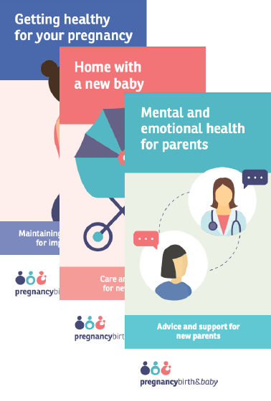
Maternal Wellbeing
Pre-Pregnancy - every pregnancy is planned and wanted
During Pregnancy & Delivery - WHO recommendations on maternal and newborn care for a positive postnatal experience: strengthening the maternal and newborn care continuum
‘every pregnant woman and newborn receives quality care throughout pregnancy, childbirth and the postnatal period’
https://images.app.goo.gl/K6oHGXyJdXH9LxwCA
7
Notes:
Pregnancy is a physiological state that should be planned for and cared for by a team.

Slide 9
Schematic representation of the WHO postnatal care model
Critical phase for maternal and newborn health
Essential for sustainable development and reducing health inequity
'positive postnatal experience,’
Central woman-newborn dyad
Promoting high-quality, individualized care.
Key recommendations:
Universal screening for newborn conditions
Maternal mental health
https://www.ncbi.nlm.nih.gov/pmc/articles/PMC9887708/
Notes:
The postnatal period is a critical phase for both maternal and newborn health, essential for sustainable development and reducing health inequity.
Despite this, coverage and quality of postnatal care are still suboptimal, especially in low-income countries.
The WHO has released a comprehensive guideline with recommendations for maternal and newborn care, health systems, and health promotion interventions during the postnatal period.
This guideline emphasizes the importance of a 'positive postnatal experience,' centering on the woman-newborn dyad, and promoting high-quality, individualized care.
Key recommendations include universal screening for newborn conditions, prioritizing maternal mental health, and interventions for common postnatal issues.

Slide 10
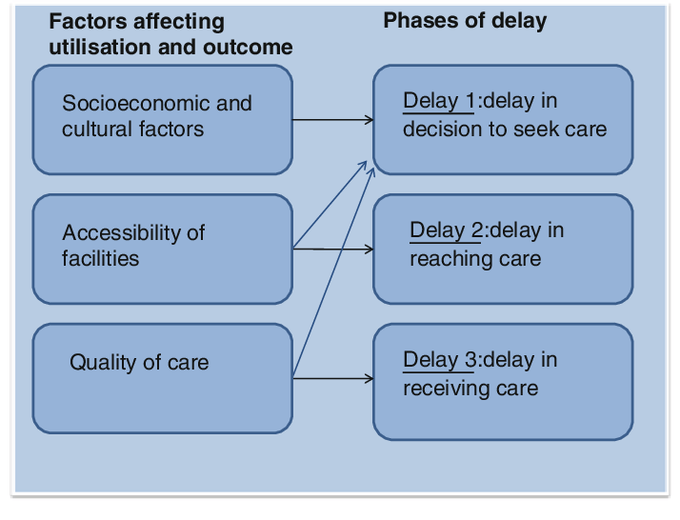
The three delays model – Pregnancy related Mortality
A role for telehealth and telemedicine ?
Technology to assist the patient and her family in the community
Digital communication, Infomercials, posters
Health checks reminders, patient info sites
National health screening and wellness events
Helplines
Technology to assist accessibility
Technology to assist the provision of care
Wifi in health facilities
Access to virtual training and upskilling of staff on site
https://images.app.goo.gl/4RvZb9GXYGPGJZxf6
9
Notes:
"Three Delays" model proposes that pregnancy-related mortality is overwhelmingly due to delays in making the decision to seek help, accessing help, and receiving help once at the medical facility.
There is a role for technology here with telehealth and telemedicine and the use of these more specific tools listed.
Technology can assist at all three levels of delay.

Slide 11
Maternal Wellbeing – Tech Support
Maternal education & training
Develop a free App that can inform women in the local language about the pregnancy danger signs
Assist in improving communication and referrals
Invest improving technology and communication in hospitals and first responders
Examples of Pregnancy support Apps, tools & resources
Ma-Jaan App - https://bangladesh.unfpa.org/en/news/revolutionizing-maternal-health-urban-bangladesh
Centre for Perinatal Excellence (COPE) App: https://onelink.to/p2kc5q
https://www.cope.org.au/readytocope/
Perinatal Anxiety & Depression (PANDA) Mental Health Checklist - https://panda.org.au/checklist
Notes:
This slide offers examples of tech support in the way of Apps used to support maternal health and well being.
Technological advancements have significantly reduced maternal mortality rates in Bangladesh, with improved prenatal care and child nutrition as key indicators.
A notable effort is the 'Solving Referral Challenges for Urban Poor to Access Emergency Obstetric and Newborn Care' project, funded by UNFPA and uses the 'Ma Jaan' app to connect pregnant women in emergencies to nearby hospitals.
COPE – Centre of Perinatal excellence – Australian based company, providing support for the emotional challenges of becoming a parent

Slide 12
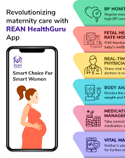
Reproductive Health
Health Helplines
Telehealth
Online education hubs
Website resources and checklists
Suite of translated information and resources
Notes:
And further examples of current technological models available to support reproductive health

Slide 13
Polycystic Ovarian Syndrome
https://www.monash.edu/__data/assets/pdf_file/0003/3379521/Evidence-Based-Guidelines-2023.pdf
https://www.monash.edu/medicine/mchri/pcos
https://youtu.be/DJQdO0EuT78
https://www.who.int/news-room/fact-sheets/detail/polycystic-ovary-syndrome
Notes:
PCOS a significant public health problem and is one of the commonest hormonal disturbances affecting women of reproductive age.
The condition affects an estimated 8–13% of women of reproductive age, and up to 70% of cases are undiagnosed.
The biological and psychological effects of PCOS, particularly those related to obesity, body image and infertility, can lead to mental health challenges and social stigma
PCOS can cause hormonal imbalances, irregular periods, excess androgen levels and cysts in the ovaries.
Irregular periods, usually with a lack of ovulation, can make it difficult to become pregnant. PCOS is a leading cause of infertility.
It is a chronic condition and cannot be cured. However, some symptoms can be improved through lifestyle changes, medications and fertility treatments.
The cause of PCOS is unknown but women with a family history or type 2 diabetes are at higher risk.
Established in 2011, The Monash Centre for Health Research and Implementation (MCHRI) are leaders in PCOS and early menopause research.
They have updated PCOS guidelines and created resources that are being used in 193 countries
They have developed the Ask PCOS App . The Ask Early Menopause App was launched this year to help women and health professionals managed early menopause

Slide 14
Menopause
Normal healthy phase
Ovulation and menstruation cease permanently
Symptoms vary in severity; mild ￫ debilitating symptoms.
80% symptomatic with vasomotor and genitourinary symptoms
25% have severe/prolonged symptoms – require treatment
https://ranzcog.edu.au/wp-content/uploads/2022/05/Managing-menopausal-symptoms.pdf
https://www.thelancet.com/series/menopause-2024
https://www.nhlbi.nih.gov/science/womens-health-initiative-whi
https://www.swanstudy.org/
http://www.askearlymenopause.org/
Notes:
Menopause is, in most cases, a normal and healthy phase of the female life course.
Symptoms of menopause vary in severity; some individuals experience mild symptoms, whereas others have debilitating symptoms.
The diagnosis of menopause is clinical, based on cessation of menstruation for a period of 12 months.
For younger women or if the diagnosis is uncertain, elevated gonadotrophins (FSH) and a low oestradiol on 2 occasions can confirm menopause. AMH is not currently recommended to predict or diagnose menopause.
Most women do not require medical treatment for menopausal symptoms.
Most women (around 80%) experience symptoms at menopause, most commonly hot flushes and/or night sweats and vaginal dryness. These usually do not need medical treatment but around 25% of women have severe and/or prolonged symptoms that may require medical intervention. For those who request treatment, drug free, non-hormonal and hormonal treatments are available.

Slide 15
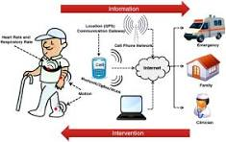
Futuristic Medicine (current & emerging)
Telemedicine
Wireless electronic fetal monitoring
Robotic-assisted surgery
Advanced imaging 3D ultrasound, Portable USS
Artificial Intelligence - fitness trackers, ovulation tracker
Remote wearable devices and trackers detect irregular heart rhythm, blood sugar levels, impending seizures
Notes:
What are some emerging technologies and treatments in womens health.
Wireless electronic fetal monitoring - Sensors that communicate via Bluetooth are attached to the mother’s abdomen with adhesive PET patches.
The device’s clever use of electronics and high sensitivity make its data extremely accurate, thereby enabling essential, life-saving early interventions.
Robotics
Advanced imaging - Advanced medical imaging is developing steadily, offering sharper pictures of the pelvic cavity and organs for obstetricians and gynaecologists to assess. 3D ultrasound systems can offer healthcare professionals complete views of the cervix, uterus, ovaries and fallopian tubes
Artificial Intelligence – detect FHR, uterine contractions, identify cancer in mammograms
Remote wearable devices and trackers are emerging across all areas of women’s healthcare and include, in addition to the traditional step tracker, ovulation and fertility calendars, irregular heart rhythms, blood sugar levels, and impending seizures can be detected.

Slide 16
In summary…
Integration of biopsychosocial determinants of health
Importance of positive well-being and vitality
We learn from positive and negative well-being (COVID)
Historical evolution of health to well-being
Holistic approach to female well-being
Value of collaboration in achieving holistic health goals
Notes:
In conclusion,
understanding women's health requires integrating social, psychological, and biological determinants.
We learn from positive and negative exposures affecting health outcomes (COVIDD taught us our to become more resourceful and tech savvy).
Positive well-being, including vitality, is a crucial predictor of future health.
A holistic approach is especially vital for female well-being, addressing unique health needs and promoting vitality.
Achieving these holistic health goals necessitates collaboration among healthcare professionals, researchers, and community organizations.
**Concluding Quote:**
"Health is more than the absence of disease. It is something positive, and involves physique and vitality, and it is mental as well as physical." - George C. Whipple, co-founder of Harvard School of Public Health, 1916.

Slide 17
Remember…
The health of women transcends the mere absence of disease; it is about embracing vitality, mental strength and social well-being.
Through collaborative efforts and a holistic approach, we can nurture a thriving female population that drives progress and prosperity

